Slide 1

CCAgent
Shota Kimata, Yuko Sakurai
Nagoya Institute of Technology

Slide 2
Features of CCAgent
We develop CCAgent for Supply Chain Management League (OneShot).
CCAgent is based on SimpleAgent.
CCAgent applies cooperative and compromising strategies.

Slide 3
SCML-2023 Oneshot
Our consideration for an agent’s strategy has shifted from price to quantity.
The range of possible prices has narrowed.
It’s now two consecutive integer values (high or low).
The impact of price on utility has decreased.
Everything except price is the same as last year.

Slide 4

The points to be considered: quantity
It's not about price, but quantity.
Ideally, the target quantity should be achieved without any shortfall or excess.
However, concurrent negotiations makes it difficult to achieve a perfect balance.
Our preliminary experimental results show that
a seller’s utility tends to decrease when there is an excess of products, and
a buyer’s utility tends to decrease when there is a shortage of products.

Slide 5
Main Idea of CCAgent
Quantity: Over-selling/over-buying
Price: Bull and bear strategy
Offer: bullish strategy
Accept: bearish strategy

Slide 6

Offer Strategy of CCAgent
We apply a cooperative strategy.
CCAgent proposes an acceptable quantity by considering the opponent’s proposal.
Quantity:
The smaller of the quantity offered by an opponent and the quantity currently needed is proposed.
CCAgent always offers the quantity offered by an opponent or below.
Price:
CCAgent proposes her best price.
When CCAgent is a buyer, she offers a low price.
When CCAgent is a seller, she offers a high price.

Slide 7

Accept Strategy of CCAgent
We apply a compromising strategy.
Quantity:
CCAgent accepts a proposal even if the proposed quantity is one more than currently required.
She rejects a proposal when the proposed quantity is two more than currently required.
She finalizes a negotiation when the quantity currently required is 0 or below.
Price:
She always accepts the trading price proposed by an opponent.

Slide 8
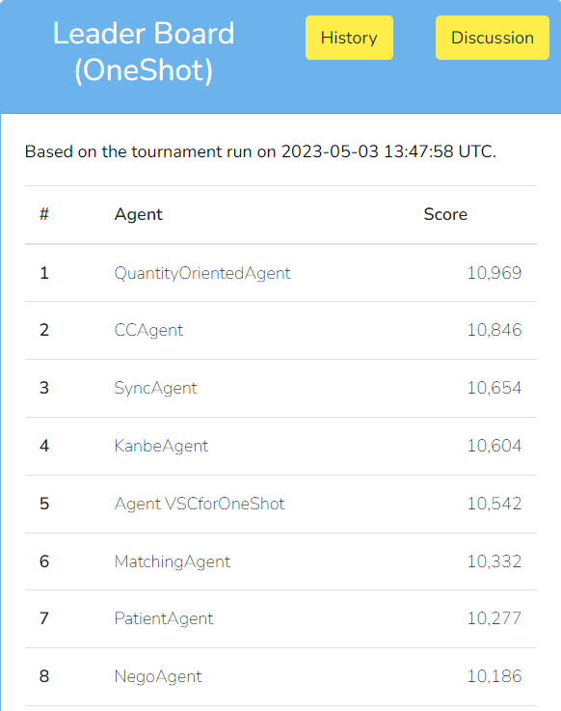
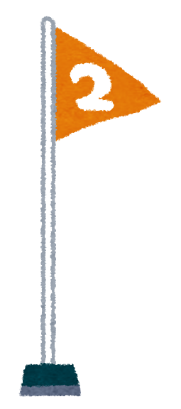
Experimental Results
 | Average Score (100 games)
CCAgent | 11,016
SimpleAgent | 10,924
CCAgent outperforms SimpleAgent!
Last online tournament on May 3rd, 2023
CCAgent is ranked second!
QuantityOrientedAgent
10,969
CCAgent
10,846
SyncAgent
10,654

Slide 9
Conclusions
We developed CCAgent based on SimpleAgent.
CCAgent applies cooperative and compromising strategies.
CCAgent is second at the last online tournament on May 3rd, 2023.
The future work includes predicting an opponent‘s acceptance strategy.

